Slide 1
Priority Queue

Slide 2
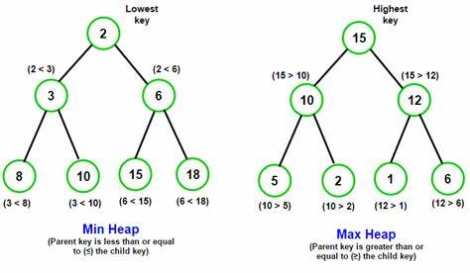
Introduction to Priority Queue
A priority queue is a data structure where each element is assigned a priority, and elements with higher priorities are processed first. Typically implemented with a max-heap or min-heap.
Uses
Real-time systems
Algorithms like Dijkstra's and Prim’s
In case you are wondering what is max-heap and min-heap check the below diagram, we will discuss it further

Slide 3
Priority Queue - Properties
Properties
Each element has a priority.
Higher priority elements are dequeued first.
Elements with the same priority follow the insertion order.

Slide 4
Operations in Priority Queue
The primary operations in a priority queue include:
Enqueue (Insertion)
Dequeue (Deletion)
Peek (Get Highest Priority Element)

Slide 5
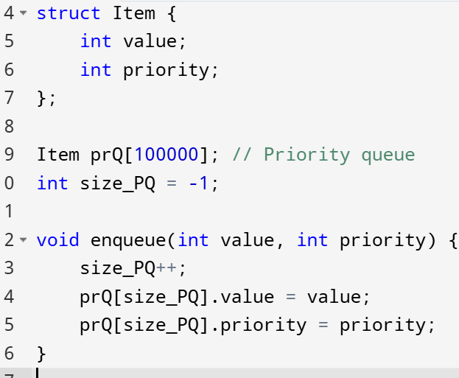
Operation 1: Enqueue
Inserts an element into the priority queue based on its priority.

Slide 6
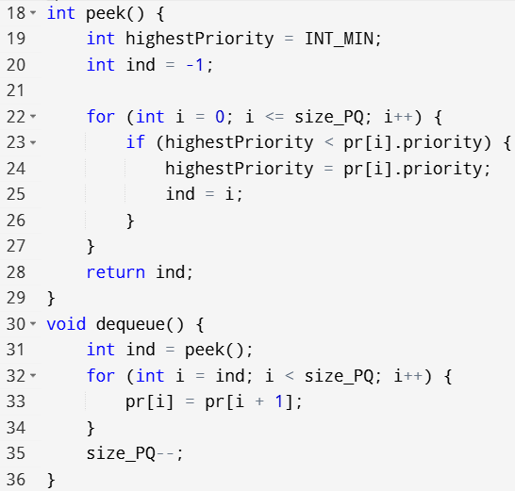
Operation 2: Peek

Slide 7
Operation 3: Dequeue
Removes the element with the highest priority from the queue.

Slide 8
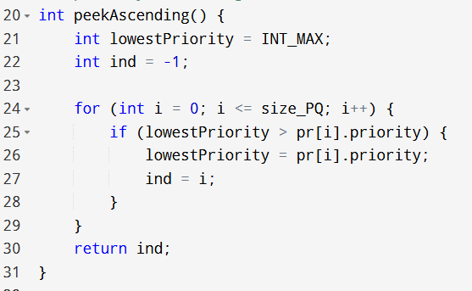
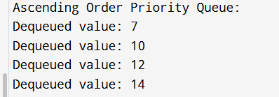
Ascending Order Priority Queue
In an ascending priority queue, elements with lower values have higher priority.

Slide 9
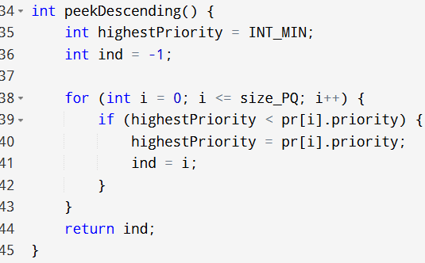
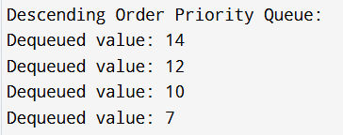
Descending Order Priority Queue
In a descending priority queue, elements with higher values have higher priority.

Slide 10
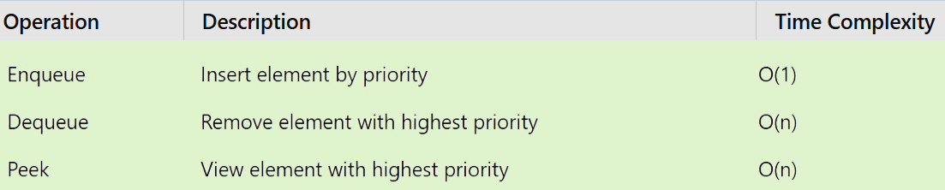
Summary of Priority Queue Operations

Slide 11
Applications of Priority Queue
Graph Algorithms: Dijkstra's shortest path, Prim's MST.
Operating Systems: Job scheduling.
Data Compression: Huffman coding.

Slide 12
Advantages of Priority Queue:
Faster Access to Elements: Priority queues allow easy retrieval of the highest priority element without scanning the entire queue, improving access speed.
Dynamic Reordering: Elements can have their priorities updated, enabling the queue to dynamically reorder based on changes in priorities.
Efficient Algorithm Implementation: Priority queues are used in algorithms like Dijkstra's and A* search, which helps improve their efficiency, especially for tasks like finding shortest paths or pathfinding.
Real-Time Systems Usage: Priority queues are well-suited for real-time systems where quick access to the highest priority element is critical, ensuring timely decision-making and processing.

Slide 13
Disadvantages of Priority Queue:
High Complexity: Priority queues are more complex than basic data structures like arrays or linked lists, making them harder to implement and manage.
High Memory Consumption: Each element in the priority queue requires additional memory to store its priority value, which can be a concern in resource-constrained systems.
Not Always the Most Efficient: In some cases, other data structures, such as heaps or binary search trees, might offer better performance for specific operations, like finding the minimum or maximum element.
Less Predictable: The order of elements is determined by their priority, making it less predictable compared to data structures like stacks (LIFO) or queues (FIFO), which have a fixed order for element retrieval.

Slide 14
Code
https://docs.google.com/document/d/19zhgI54yTcybPTsXQBwz8NZX4tlqKd_MiTWuy6TBqms/edit?usp=sharing

